Slide 1
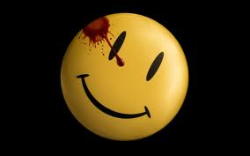
Superheroes Deconstructed
Revisionist (Super)heroism

Slide 2
Class Contemplation
To Whom do we grant power?

Slide 3
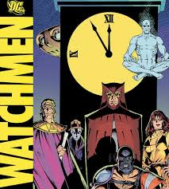
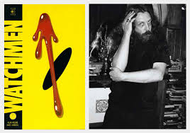
The Watchmen
Published 1986 Originally as single-issue series
1987 published as a novel
Alan Moore: writer
Dave Gibbons: Illustrator
John Higgins: Colorist

Slide 4
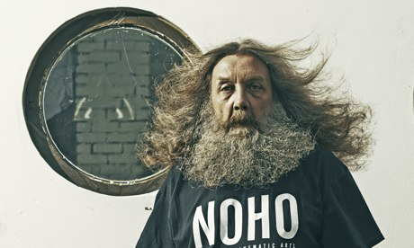
Alan Moore
“I haven't read any superhero comics since I finished with ‘Watchmen.’ I hate superheroes,” Moore told the Guardian in an interview published late last week. “I think they're abominations. They don't mean what they used to mean. They were originally in the hands of writers who would actively expand the imagination of their nine- to 13-year-old audience. That was completely what they were meant to do and they were doing it excellently. These days, superhero comics think the audience is certainly not nine to 13, it's nothing to do with them. It's an audience largely of 30-, 40-, 50-, 60-year old men, usually men.”

Slide 5
New Approach to Comic book Superheroes
Rebirth of comics rooted in two texts:
The Dark Knight Returns
The Watchmen (treatment of Rorschach)
Psychological approach to superheroes
More complex portrayals
Shift to more adult, serious readership

Slide 6
The Watchmen: Premise
Story set in the mid-1980’s (1985 specifically)
Situate superheroes in the real world
The real world is a place that previous superhero comics did not explore
How does their presence in the real world change the real world?
Psychological shift
Emotional feel of the real world changes

Slide 7
Deconstruction of Superhero
Post-1980’s: superhero conventions disrupted
Super identities no longer
Batman characterized as psychotic
Traditional selflessness is problematized
Idea of the mission breaks down
Both TDKR and Watchmen
Governance and society taken over by the superhero(es)
Focus on death—heroes of both texts die (figuratively and literally)
Demise of the genre?
1980’s revival is also the death of the traditional superhero

Slide 8
Deconstruction cont’d
Oppositional and/or subversive posture
Self-reflexivity (draw attention to its own conventions)
Less about the story and more about the conventions of superhero
Superhero character brought into question
Hero is less super; dark; morality is in question; brutality blurs the lines between heroes and criminals

Slide 9
Why Are Superheroes Always Good?
Watchmen/TDRK pose this important question: Can there be such as thing as superheroes with questionable values without making them supervillains?
Problematic motives and methods (linked with vigilante justice)
Rorschach & Dr. Manhattan (both morally distant from human experience
Questioning the heavy reliance that superheroes are supposed to be (ought to be) good
Questioning superhero psychology & values
Reminds us that superheroes cannot simply be good by definition
The superhero must choose to be good and must continue to be good (recognizably)

Slide 10
Cultural/Historical context (Anti-Comics Movement)
Good superhero were legislated to be good in the industry
Based on the anti-comics movement of the 1950’s and the creation of the Comics Code Authority (CCA)
Publishers bound by this Code
Original Comics Code: “In every instance good shall triumph over evil and the criminal shall be punished for his misdeeds”
While it dwindled in power eventually, it upheld the basic constraints of comics storytelling for decades

Slide 11
Make them more Human
Conflict is central to human experience
Plotline: good versus evil is not so simple—extraneous moral and philosophical issues
These issues eventually took center-stage
Superheroes became fully-dimensional
Spiderman—existential crisis—focus on his motivation for being a hero

Slide 12
Origin Stories
Gives explanation for why Superheroes act the way they do
Created, adjusted, embellished
Causal role in shaping their “fates”
E.g. Genetic makeup or personal upbringing
Foundation of Superhero personality or mission
Explain why Supervillains are evil
Lex Luthor origin story—feels personally attacked by Superman
Luthor’s hate for Superman is all personal, therefore his mission is to destroy Superman primarily
Offer signs and interpretations of character (more than explanations)

Slide 13
Problem with Origin Stories
“No single event or handful of experiences, however profoundly impressed upon us, altogether determines the choices we make or the attitudes we adopt towards those experiences” (Brenzel 154).
It is not that simple—there is more to it
Therefore origin stories fall short in explaining Superhero choices—why they choose to do good or evil

Slide 14
Why we Love them
Superheroes inspire us b/c they resist and deny the view that all humans are by nature self-seeking (Spiderman trajectory)
Humans strive towards reaching their own potential for excellence (achieving your full potential)
Superheroes must face the same questions about reaching their own potential for excellence

Slide 15
Watchmen
Superheroes attempt to figure out where they belong in society
How they fit into the world of other superheroes
They have to learn about themselves
Ask what the best kind of life they can lead
Where and how their powers fit in
What they can offer or receive from others

Slide 16
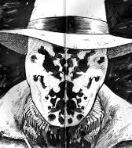
Rorschach Mask

Slide 17
Rorschach
“never compromise…evil must be punished” (XII: 20-23).
He resists Ozy’s explanation /justification of the deaths
Implication is that it is right to inflict widespread pain and suffering of innocent people for the greater good
Ozy’s plan of action questions morality: is he a monster or a misunderstood savior?

Slide 18
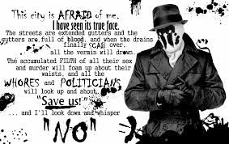
Rorschach’s Vision

Slide 19
Rorschach’s vision
Bleak, nihilistic vision
Responsibility of justice
Moore forces reader to confront it themselves
What happens if we give up responsibility to someone else (others)?
Who has the right to decide how we should be protected?
How do we allow people like Ozy into positions of power?
Should we not be making those decisions about our lives ourselves?

Slide 20
Rorschach
Nihilist?
Higher ideals—conviction
Contrasts Blake—no higher ideals-everything is a joke
Mask: black & white morality?

Slide 21
The Journal
His journal: same entry frames the beginning and end: “Dead dog in the alley this morning...tire tread on burst stomach” (10.24)-also appears first panel of chapter one
Journal entries interspersed throughout
Trace its journey to its final destination: New Frontiersman office

Slide 22
Narrative Point of View
If Seymour picks up the journal (its in his hands), then the whole story could be told through his perspective
Rorschach’s journal becomes the narrative frame if this is the case
A story told by an omniscient narrator ?
The end of the novel becomes the beginning
Who is the narrator?

Slide 23
“Who watches the Watchmen?”
The epigraph for the book: appears throughout the book in graffiti slogan
Latin, "Quis Custodiet Ipsos Custodes?”
From the ancient writer, Juvenal
The last line of the book
It frames the entire book
Can anyone occupy the position of being the Watchmen over the world?
Can anyone occupy the position as judge, jury, and executioner?
Can we trust anyone to do the right thing for the world?

Slide 24
Who Watches the Watchmen?
The actions of those who don’t work for the government are questioned
Superman in TDKR; Dr. Manhattan; The Comedian are all working for the state as government operatives
People don’t trust them—public resentment
Is it based on fear, resentment, or guilt?
A question grounded in political theory—about ethics, law & order, and political authority

Slide 25
Historical Backdrop
Set against real historical backdrop of the 1940’s and the Vietnam War (1960’s)
Imminent nuclear war between Soviet Union and United States
Superheroes have been outlawed and forced into retirement
Vigilantism reemerges during this backdrop
Very weighty issues
BUT, it is an alternate history
depicts a history that diverges from the actual history of the world

Slide 26
Minutemen
Interplay of two stories
Tells us about a group of past and present superheroes
Minutemen (original superhero league)
Versus Watchmen (Current Superheroes):
All have issues—ethical, moral, personal, psychological
All have faults, shortcomings, neuroses
Manhattan as victim to Superheroes in the real world

Slide 27
Anti-Heroism: concept
Blurs the line between good and evil
Anti-hero: “a person who occasionally does bad things for the right reasons” (Spivey and Knowlton)
The good guy, who does bad things for the right reasons
The end justifies the means
Occupies a gray area (morally)—multidimensional construct
Between black &white extremes: hero & supervillain
Sometimes referred to as “Byronic hero”

Slide 28
Anti-hero
Can be classic tragic hero—we sympathize
Spiderman?—class comic tragic hero
Not always motivated by noble principles
Sometimes have to choose between various levels of evil
High-stakes moral bargaining
Both loved and feared by audience
Batman the original anti-hero (symbolic strike from the shadows)

Slide 29
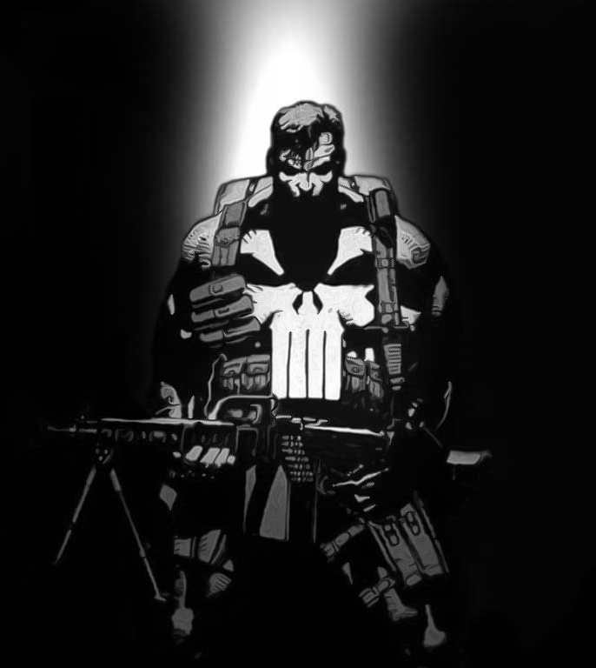
Psychological strands of Anti-hero
!. Psychopaths (the Punisher)

Slide 30
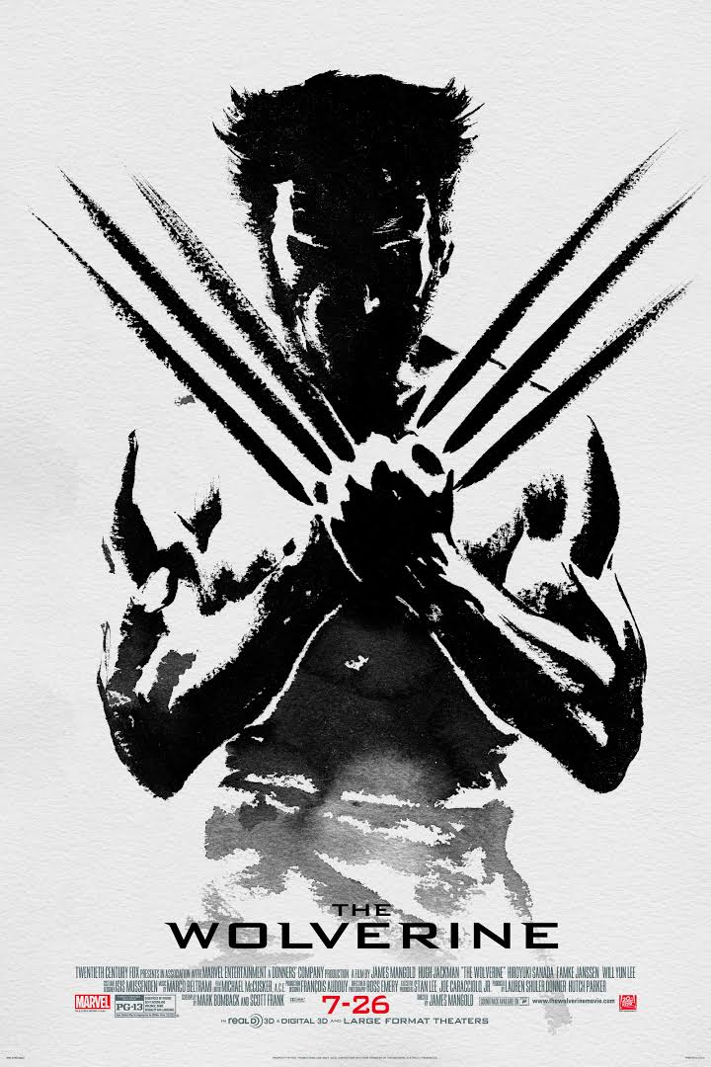
2. Antisocial personality disorder (Wolverine)

Slide 31

3. Schizoid personality disorder (Dark Knight)

Slide 32
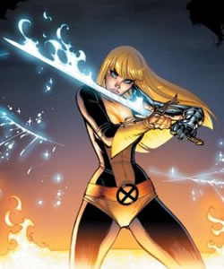
4. Sociable (Magik-Colossus’ sister-Uncanny X-Men)

Slide 33
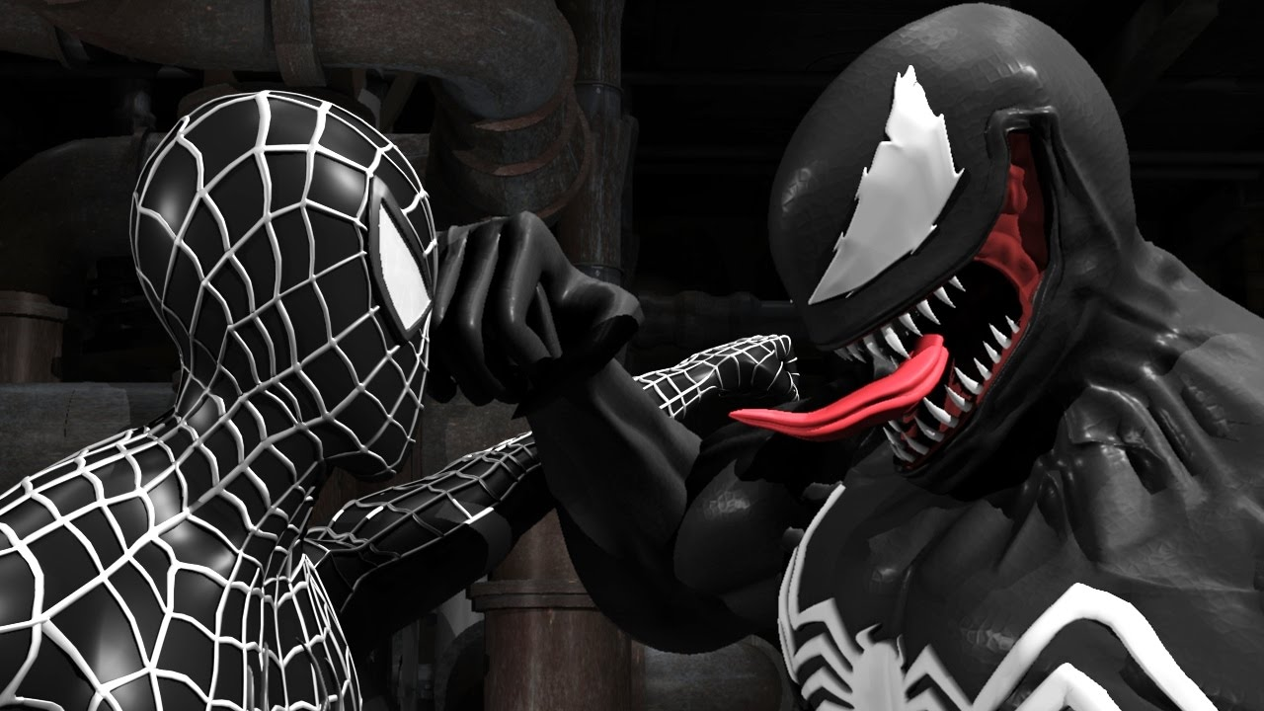
5. Multiple personality disorder (Venom?)

Slide 34
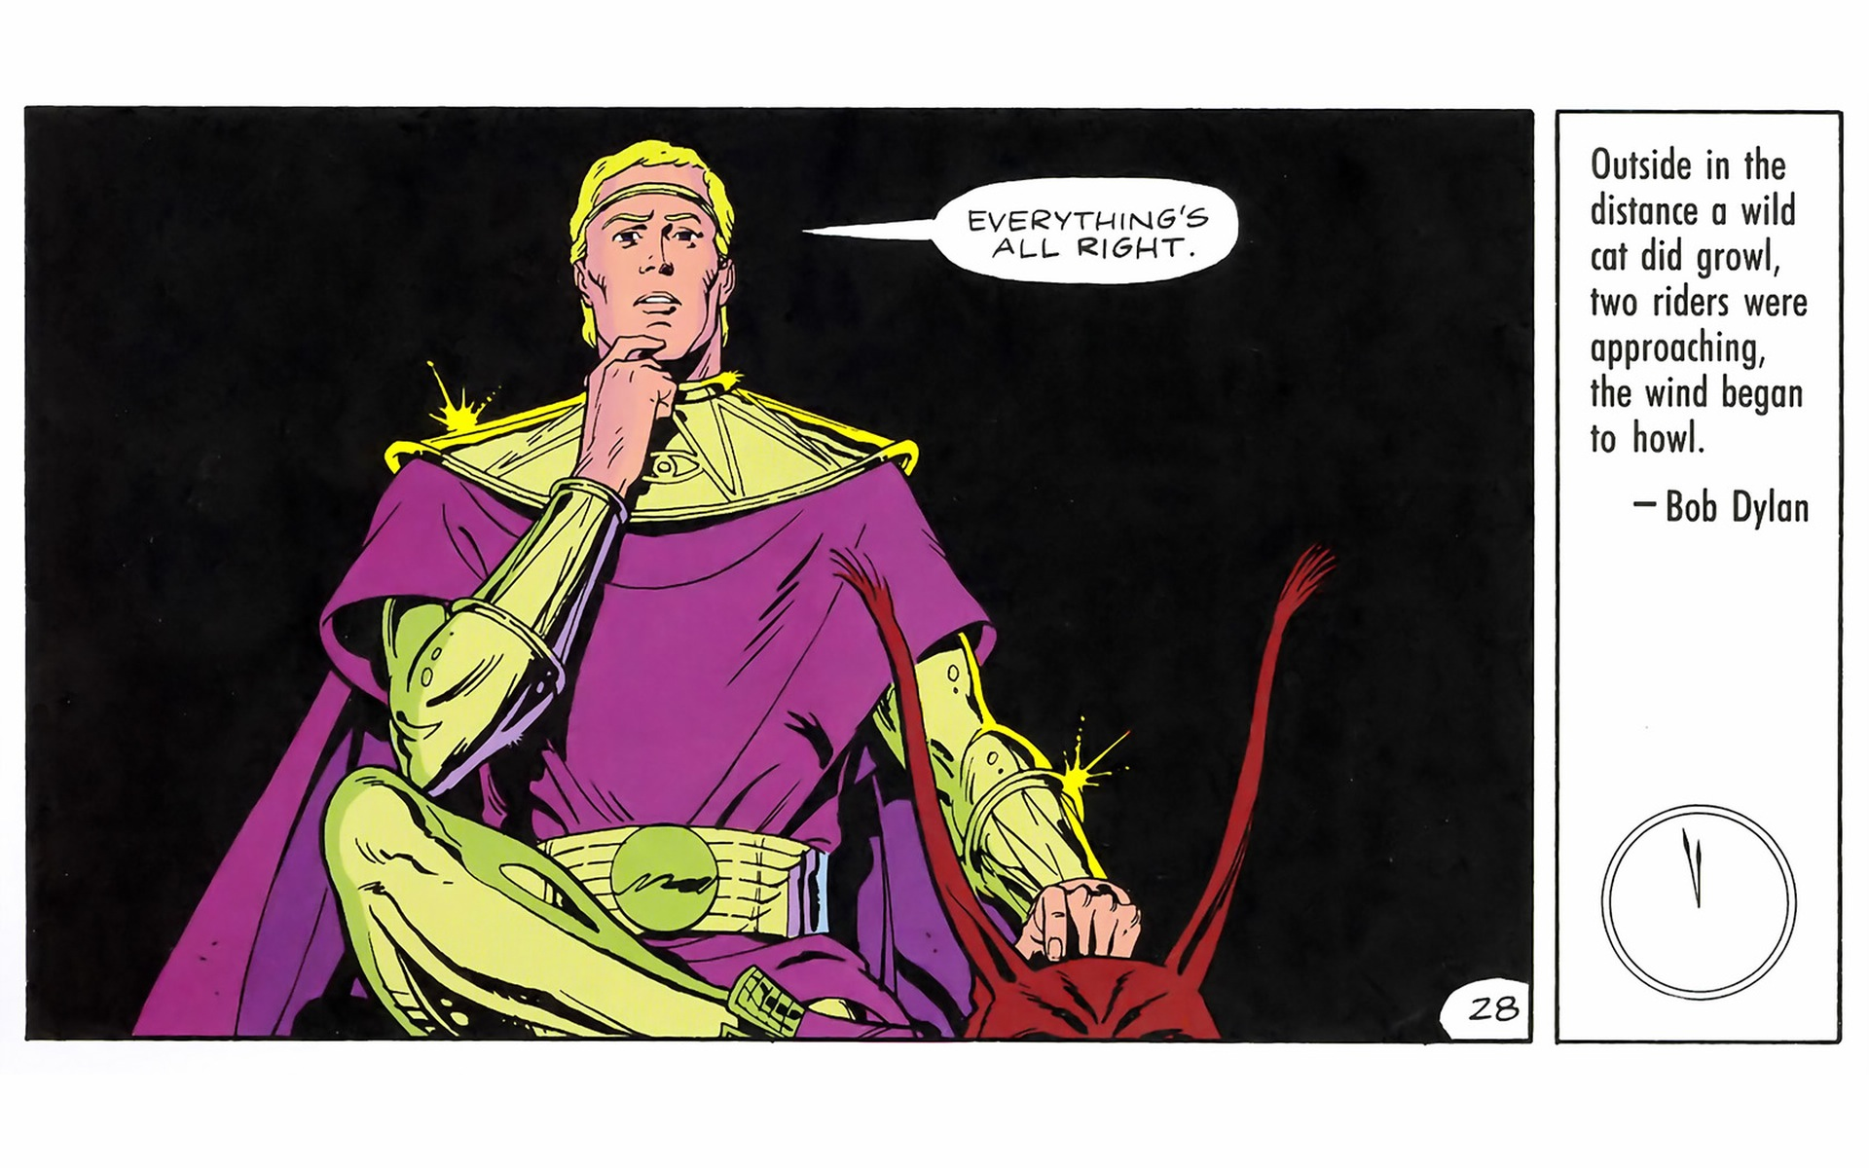
6. Narcissistic personality disorder (Ozy)

Slide 35
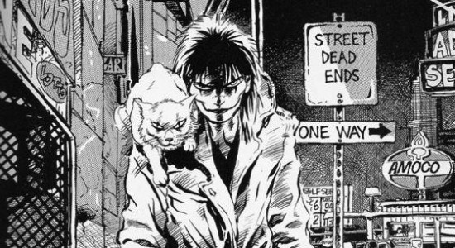
7. Clinically depressed (The Crow)

Slide 36
Space between Good and Evil
Why we love them
We see our flawed selves in them
Balance game: evil deeds with intentions
Compelling quality: mixed results

Slide 37
Narrative Structure
http://tvtropes.org/pmwiki/pmwiki.php/Comicbook/Watchmen
12 books-chapters
Time—doomsday clock—motif throughout

Slide 38
Narrative Structure
Narrative within a narrative—a comic within-a-comic: Tales of the Black Freighter
Pirate tale parallels main narrative
Non-linear
Intertext: Parallel story about a man lost at sea intent on revenge against the pirates responsible for the destruction of his ship
Point of connection: hero of the tale wants justice (outside the law)—ends up committing evil to the people he intended to avenge
Story ends in tragedy
Dangers of vigilantism versus cosmic justice

Slide 39
Sexuality--Subtext
Rape story—Silk Spectre’s backstory
Feminist vision / subtext?
Separate, special kind of crime?
Women as objects
Disposable
Silk Spectre—ideological sexual pawn
To fulfill the needs of Dr. Manhattan
Versus empowered women

